Slide 1

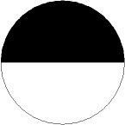
Detection of H2O2 damages to yeast genome
Cells in water
H2O2
No mutation
MET15^{+/-}
MET15^{+/+}
Mother Cells
Mutation
met15^{-/-}
First mitosis
Mutation
1st generation
Notes:
During aging, there is accumulation of oxidative damages in mother cells. Mother cells tend to keep these damages within themselves. Ideally, daughter cells should be born free of damages. Hence, the partition of cellular components is asymmetric.
The ratio of half blacks over full blacks measure how much oxidative damages are passed to the next generation.
This direction is related to DNA repair pathways.

